Slide 1
Fourier Transform

Slide 2
Fourier series
Sturm–Liouville expansions
Fourier integrals
transforms in Secs.

Slide 3
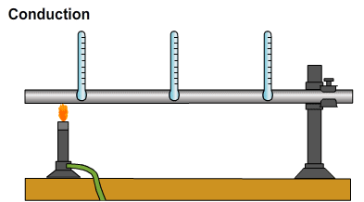

Fourier analysis
Heat Transfer.
Space x and Time t domain.
What is the temperature at
a specific Position x at time t
We should find the function of
temperature u(x,t)

Slide 4
Fourier analysis
Most real-world problems can be represented by Partial Differential Equations (PDEs).
Then, we solve the PDEs
The solution of PDEs is a function.

Slide 5
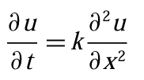





Fourier analysis
0
π
x
0
0

Slide 6

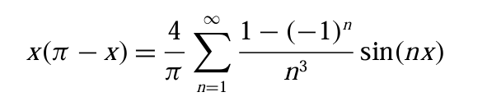
Fourier analysis
Real-world problem
PDEs
Solving
Function
Fourier analysis

Slide 7
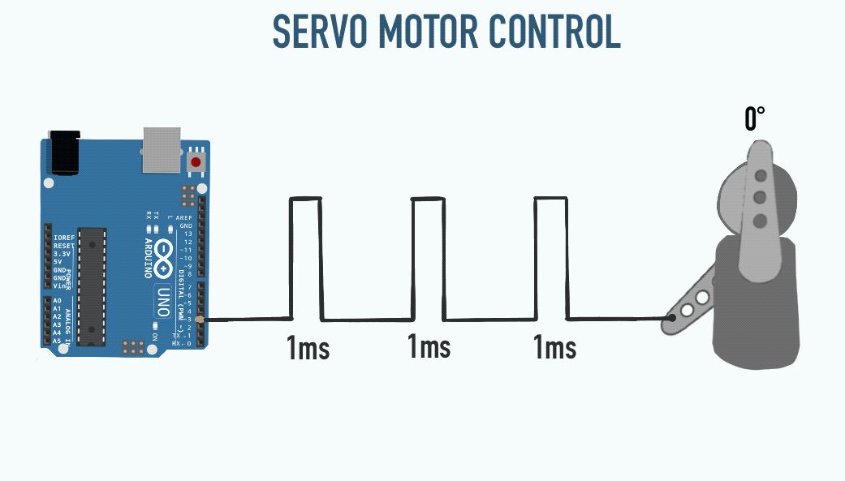
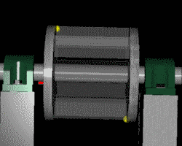
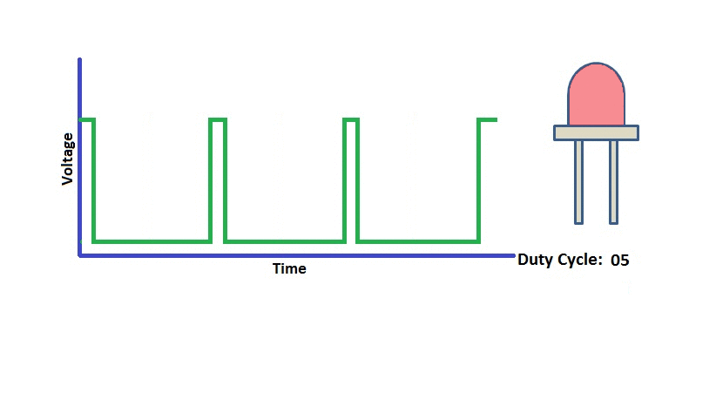
Fourier analysis
Fourier analysis allows us to model periodic phenomena.
Many physical and engineering signals are periodic, meaning they repeat exactly after some period. Think of rotating parts of machines, alternating electric currents, or the motion of planets.

Slide 8
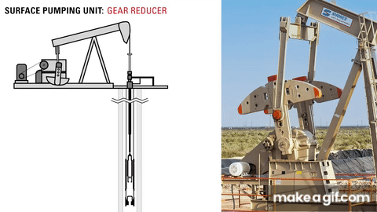
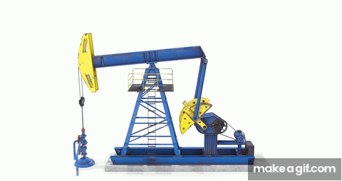
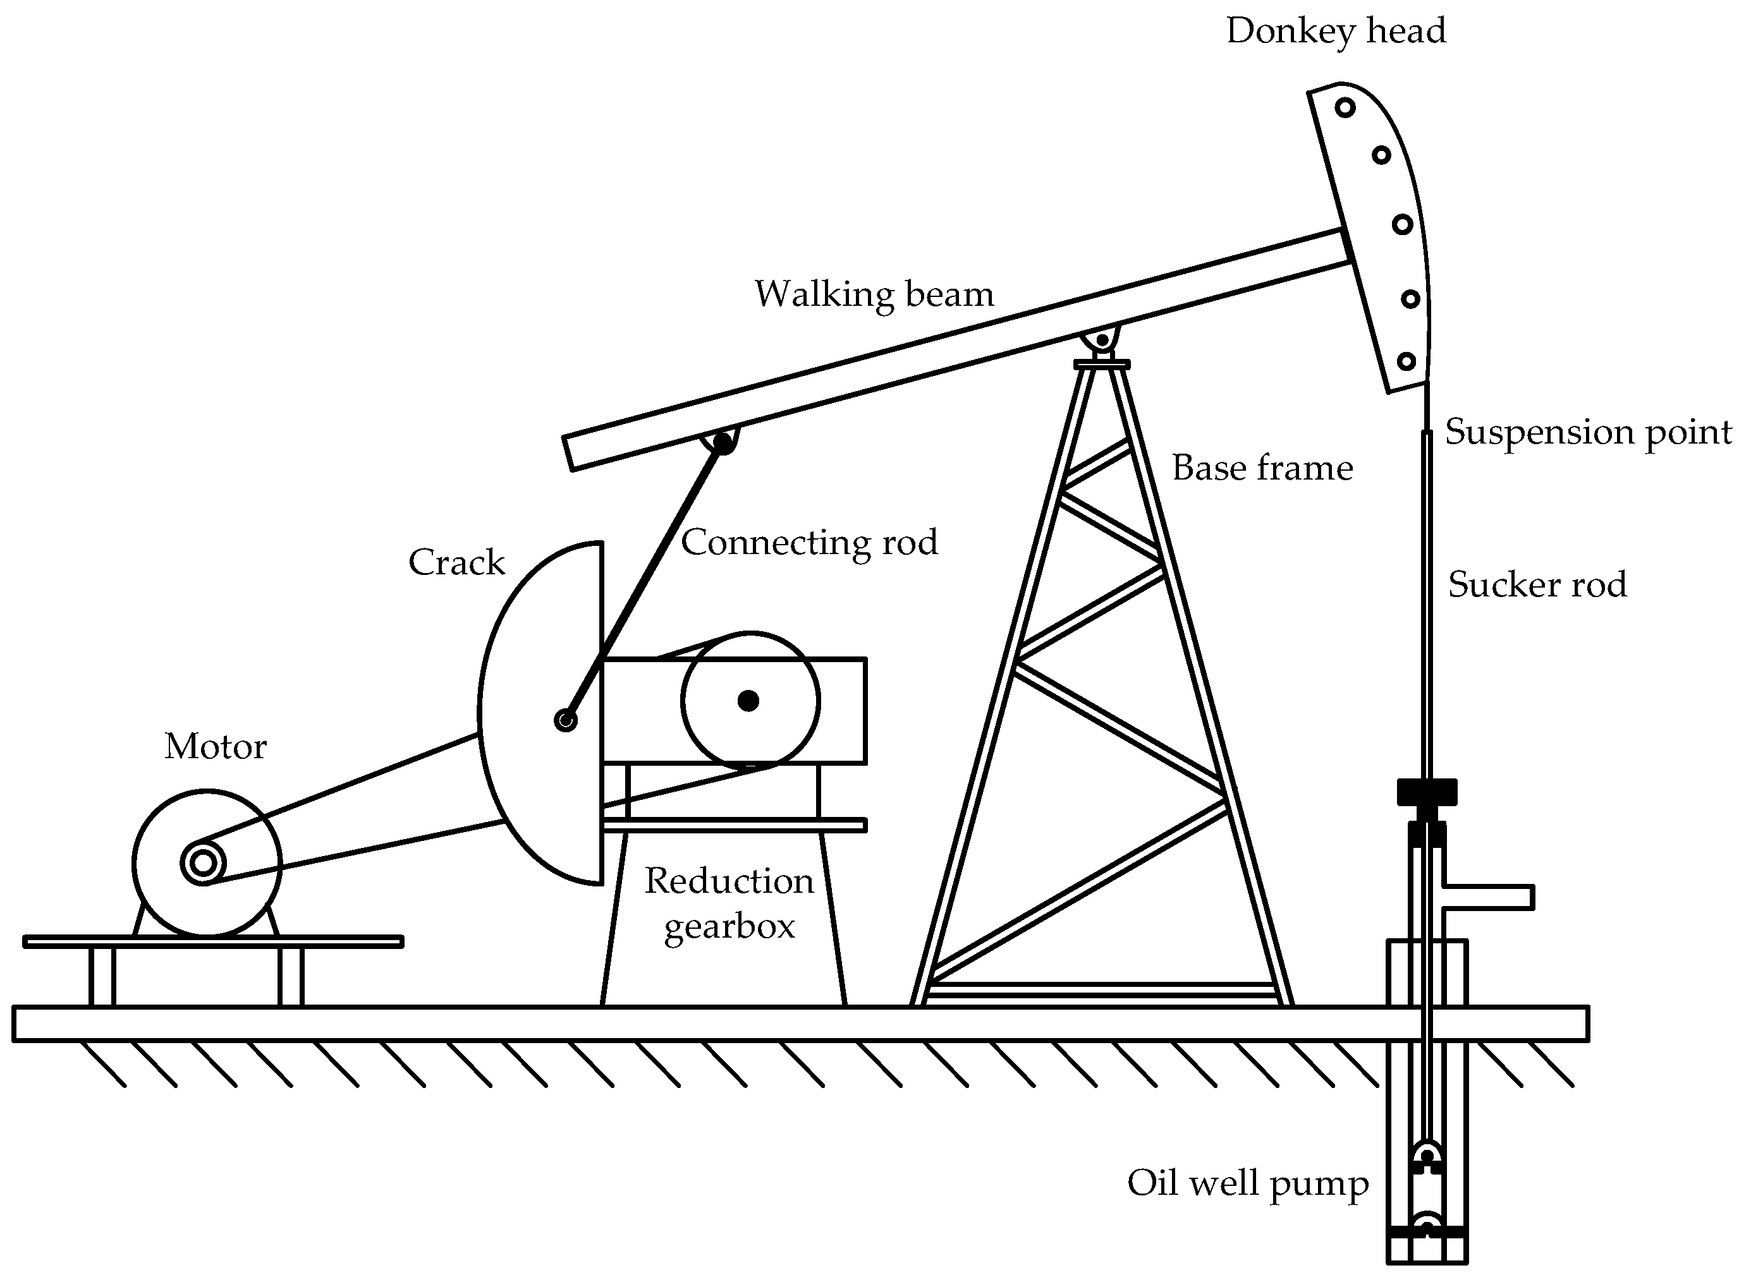
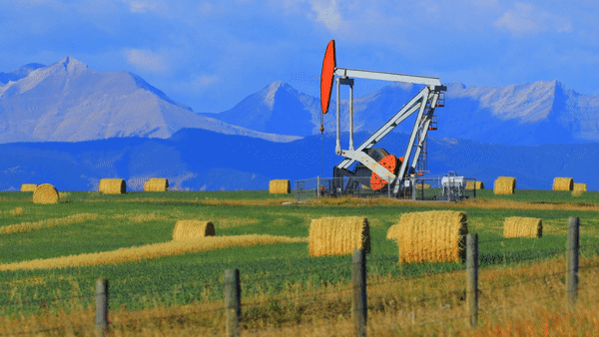
Fourier analysis

Slide 9
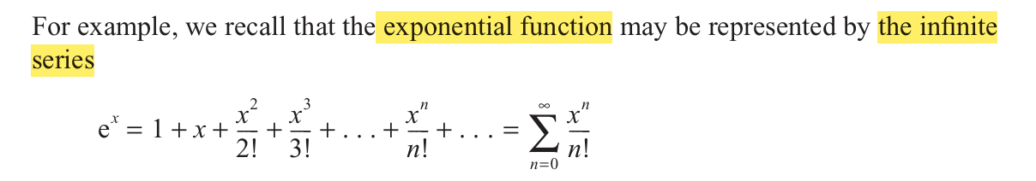
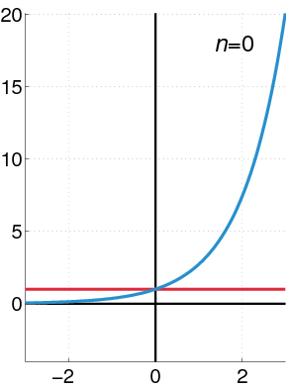
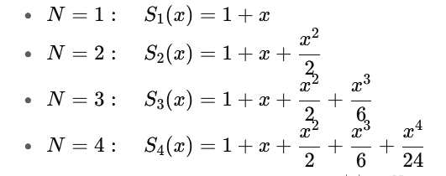
Fourier analysis

Slide 10
Fourier analysis
The ingenious idea of Fourier analysis is to represent complicated functions.
Using terms of simple periodic functions, namely cosines and sines.
Many discontinuous periodic functions that come up in applications can be developed in a Fourier series, but do not have Taylor series expansions.

Slide 11
Fourier analysis
Advantages of expanding a function of a series
Approximations.
Easy integration or differentiation.

Slide 12
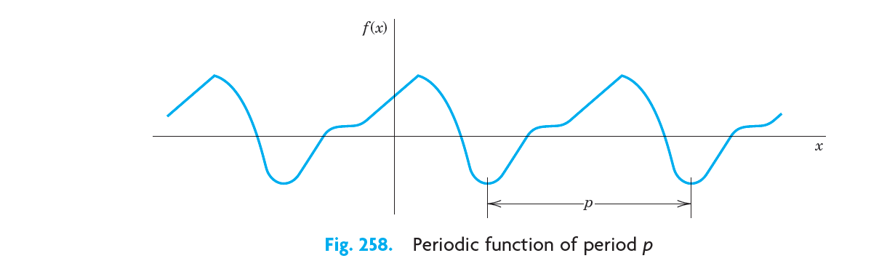

periodic function
Function f (x) is called a periodic function if f ( x) is defined for all real x, except possibly at some points, and if there is some positive number p, called a period of f (x) ,such that

Slide 13
periodic function
Periodic Functions Link

Slide 14
periodic function
Periodic Functions, Sin, Cos Link

Slide 15
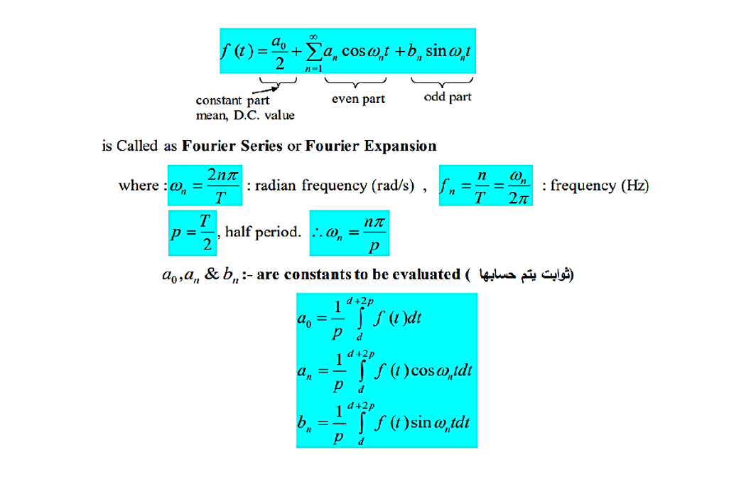
Fourier series

Slide 16
periodic function
Graphing Link

Slide 17

periodic function

